Slide 1
X-RAY
PREPARED BY
DR. AMIT KUMAR
ASSISTANT PROFESSOR DEPARTMENT OF PHYSICS
GOVERNMENT DEGREE COLLEGE UNNAO

Slide 2
What is a x-ray
X-ray is high energy electromagnetic radiation.
It is discovered by Wilhelm conrad roentgen in 1895.
frequency range of x-ray is 3×10¹⁶ Hz to 3×10¹⁹ Hz and corresponding wavelength range is from 0.01nm to 10nm.
X-ray wavelengths are shorter than UV rays and typically longer than those of gamma rays.

Slide 5
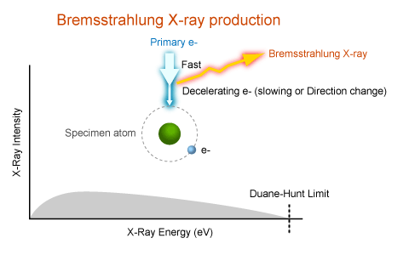

Slide 8
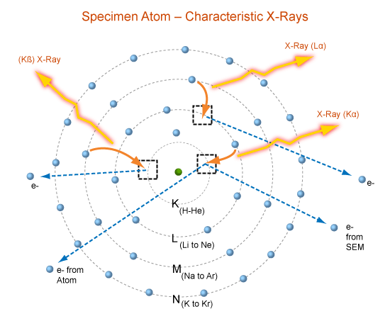

Slide 13
